Slide 1
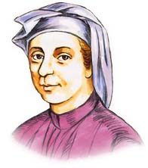
Fibonacci and its applications

Slide 2
Fibonacci series
F_{n} = F_{n-1} + F_{n-2}
F₁₃ = ?
n | 0 | 1 | 2 | 3 | 4 | 5 | 6 | 7
F_{n} | 0 | 1 | 1 | 2 | 3 | 5 | 8 | 13
Notes:
Ans: 233

Slide 3
n | 0 | 1 | 2 | 3 | 4 | 5 | 6
F_{n} | 0 | 1 | 1 | 2 | 3 | 5 | 8
F_{n}² |  | 1 | 1 | 4 | 9 | 25 | 64
 |  |  | 2

Slide 4
n | 0 | 1 | 2 | 3 | 4 | 5 | 6
F_{n} | 0 | 1 | 1 | 2 | 3 | 5 | 8
F_{n}² |  | 1 | 1 | 4 | 9 | 25 | 64
 |  |  | 2 | 5

Slide 5
n | 0 | 1 | 2 | 3 | 4 | 5 | 6
F_{n} | 0 | 1 | 1 | 2 | 3 | 5 | 8
F_{n}² |  | 1 | 1 | 4 | 9 | 25 | 64
 |  |  | 2 | 5 | 13 | 34 | 89
Fibonacci

Slide 6
n | 0 | 1 | 2 | 3 | 4 | 5 | 6
F_{n} | 0 | 1 | 1 | 2 | 3 | 5 | 8
F_{n}² |  | 1 | 1 | 4 | 9 | 25 | 64
 |  |  | 2

Slide 7
n | 0 | 1 | 2 | 3 | 4 | 5 | 6
F_{n} | 0 | 1 | 1 | 2 | 3 | 5 | 8
F_{n}² |  | 1 | 1 | 4 | 9 | 25 | 64
 |  |  | 2 | 6

Slide 8
n | 0 | 1 | 2 | 3 | 4 | 5 | 6
F_{n} | 0 | 1 | 1 | 2 | 3 | 5 | 8
F_{n}² |  | 1 | 1 | 4 | 9 | 25 | 64
 |  |  | 2 | 6 | 17

Slide 9
n | 0 | 1 | 2 | 3 | 4 | 5 | 6
F_{n} | 0 | 1 | 1 | 2 | 3 | 5 | 8
F_{n}² |  | 1 | 1 | 4 | 9 | 25 | 64
 |  |  | 2 | 6 | 17 | 42 | 108

Slide 10
n | 0 | 1 | 2 | 3 | 4 | 5 | 6
F_{n} | 0 | 1 | 1 | 2 | 3 | 5 | 8
F_{n}² |  | 1 | 1 | 4 | 9 | 25 | 64
ΣF_{n}² |  |  | 2 | 6 | 17 | 42 | 108
 |  |  | 1x2 | 2x3 | 3x5 | 5x8 | 8x13
Notes:
Ref: http://gofiguremath.org/natures-favorite-math/fibonacci-numbers/fibonacci-number-patterns/

Slide 11
Golden rectangle
Length = F_{n+1} width = F_{n}
8
2
3
1
8
5
13

Slide 12
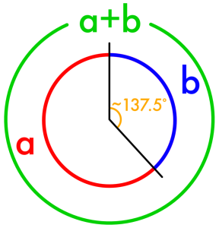
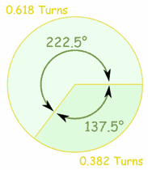
Golden angle
a : b = ( a + b ) : a = 1.618

Slide 13
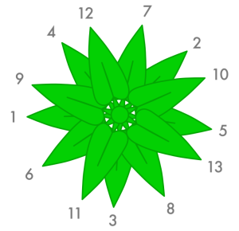
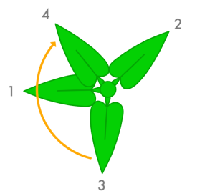
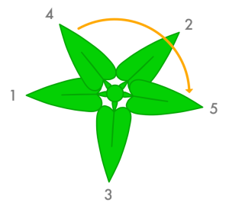
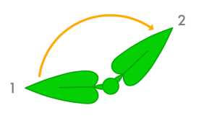
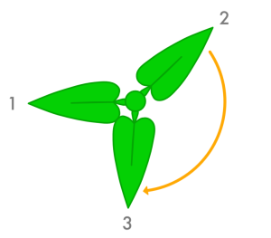

Leaves growth

Slide 14

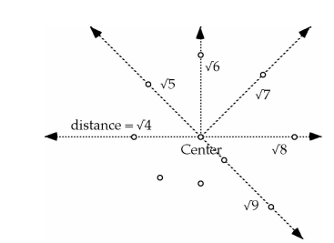
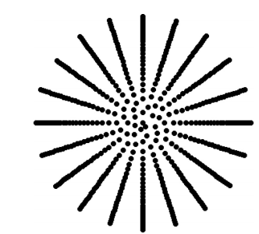
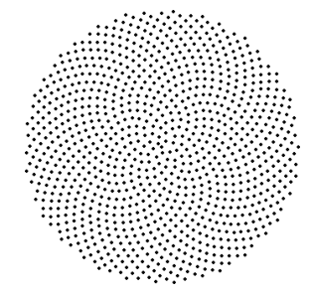
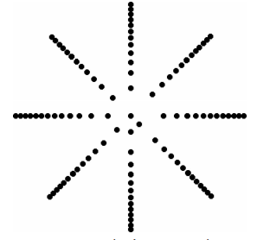
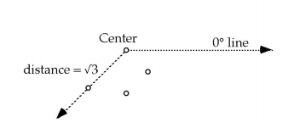
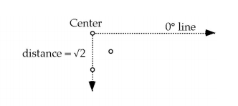
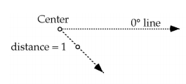
Seeds placement
100 seeds
1000 seeds
angle 222.5º (0.618)
angle 54º (0.15)
angle 172.8º (0.48)
angle 45º (0.125)
Notes:
Ref: naylor-seeds.pdf

Slide 15
Golden(Divine) Ratio
F_{n-1} : F_{n-2} =
(F_{n-1} + F_{n-2} ) : F_{n-1} =
F_{n} : F_{n-1} = 1.618

Slide 16
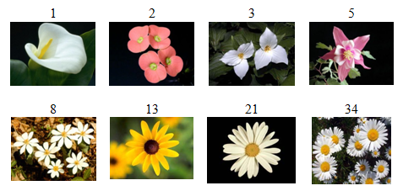
Petals of flowers

Slide 17
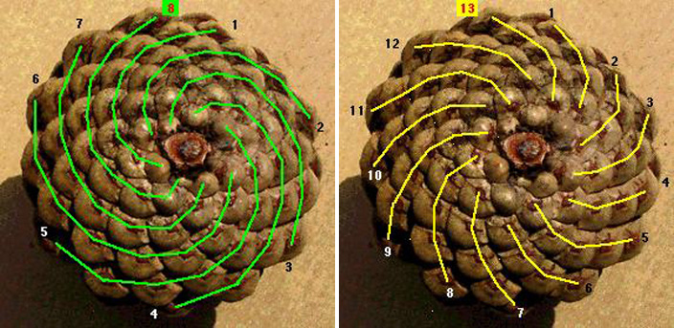
Pine cones

Slide 18
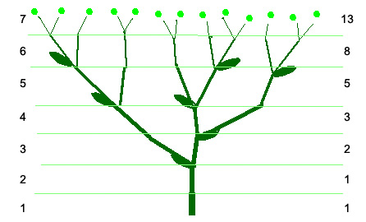
Tree branches

Slide 19
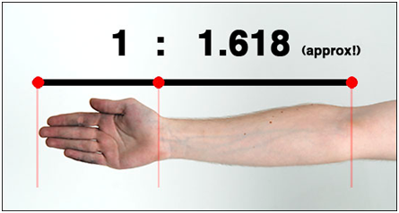
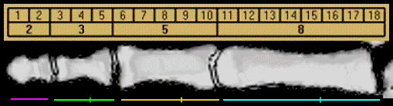
Human body

Slide 20
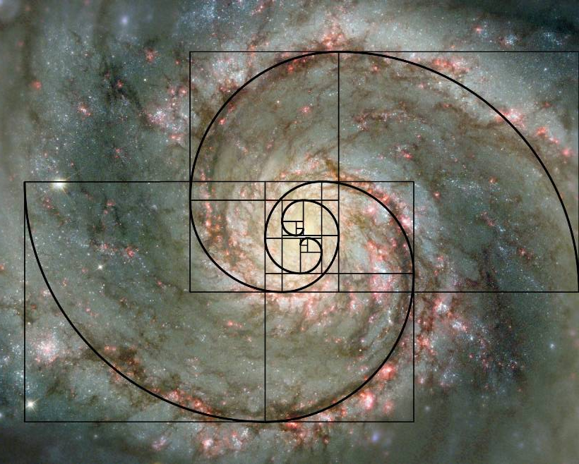
Spiral Galaxy

Slide 21
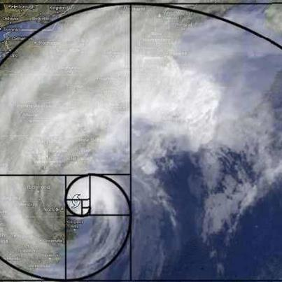
Spiral cyclone

Slide 22
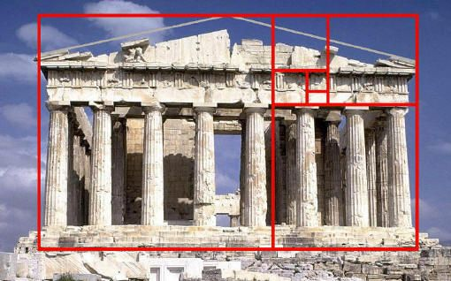
Architecture

Slide 23
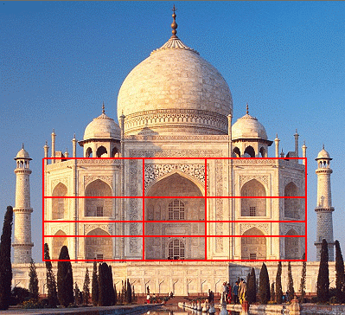
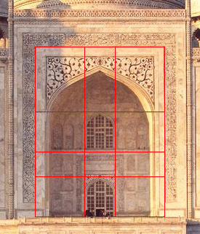
Architecture

Slide 24
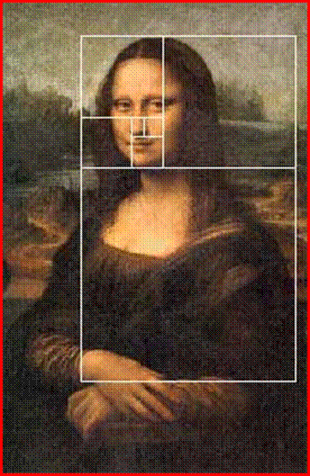
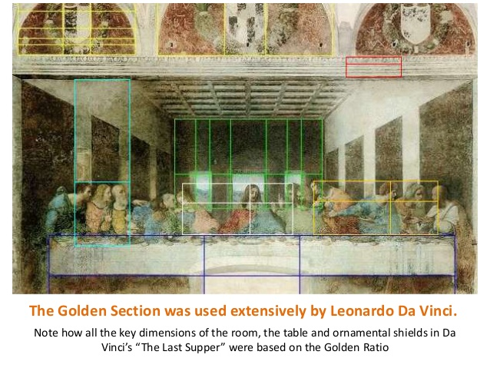
Paintings

Slide 25
Exercises
Write the fibonacci day
Find the least ‘n’ to get 1.618 ( 3 digits)

Slide 26
Exercise
You donate Rs.100 per month and inspire 1 new student every month to do the same.
Each student, in turn, inspires 1 more every month (excluding first month).
Calculate the donated amount in the 12th month.
Calculate the amount upto 12th month.
Notes:
Ans: 23300

Slide 27
Recursive version
def fibo(n):
if n <= 1:
return n
else:
return fibo(n-1) + fibo(n-2)

Slide 28
Recursive is not efficient
Call | return
fibo(5) | fibo(4)+fibo(3)
fibo(4) | fibo(3)+fibo(2)
fibo(3) | fibo(2)+fibo(1)
fibo(2) | fibo(1)+fibo(0)
fibo(1) | 1
fibo(0) | 0

Slide 29
calls tree
fibo(5)
fibo(4)
fibo(3)
fibo(2)
fibo(1)
fibo(0)
fibo(1)
fibo(3)
fibo(2)
fibo(2)
fibo(1)
fibo(1)
fibo(0)
fibo(1)
fibo(0)

Slide 30
Better version
def linear_fibo(n): if (n <= 1): return (n,n-1) else: a,b= linear_fibo(n-1)
return (a+b,a)

Slide 31
Appendix

Slide 32
Least recently used(LRU) cache
cache={}
def fibo_cache(n):
if n in cache:
return cache[n]
if n <= 1:
cache[n] = n
return n
else:
val= fibo_cache(n-1) + fibo_cache(n-2)
cache[n] = val
return val

Slide 33
lru_cache
# using lru_cache
# lru - least recently used
from functools import lru_cache
@lru_cache(maxsize=1000)
def fibo_lru(n):
if n <= 1:
return n
else:
return fibo_lru(n-1) + fibo_lru(n-2)

Slide 34
Algorithms using Fibonacci
Fibonacci search
Fibonacci merge
Fibonacci tree
Cryptography

